Slide 1
KX-NTV150/160 Basic Specification
October 26, 2015
Panasonic System Networks PBX SE team
Specifications are subject to change without notice.

Slide 2
1. Table of Contents
Chapter | Contents
1 | Overview
2 | Basic configuration
3 | AK and Conditions
Notes:
2

Slide 3
Chapter 1 Overview

Slide 4
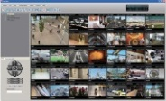
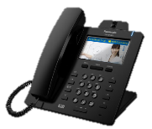
11. System Overview
System Overview
Viewer Application
NTV150/160 are IP Voice terminals with camera.
NTV160
PBX
ONVIF
SIP
Door Opener
NTV150
Video Terminals(SIP)
Web Viewer
Audio Terminals
They are one of the PBX terminals that are handled as SIP extension.
Notes:
4
<Policy>
- Easy installation and maintenance are basic policy.
- Voice Quality and PBX related feature are differentiating from network camera.
- NTV Series can be used as SIP video terminals and also monitoring camera.
- NTV Series connect to only Panasonic PBX.

Slide 5
12. System Description
Item | Description
NTV150 | Communication IP Camera
NTV160 | Video door phone
Video teminal | HDV430, SIP Softphone application
Audio teminal | PBX Audio phone (NTseries, DPT, APT etc.)
Viewer | Embedded Web Viewer by NTV150,NTV160
 | Viewer Application
KX-NTV150 and KX-NTV160 can be connected to only NS/NSX series as SIP extension.
Notes:
5

Slide 6
13. Compatible PBX
Compatible PBX
NTV150/160 can ONLY work with following Panasonic PBX.
These terminals can NOT work with 3rd party PBX, SIP server and other Panasonic
PBX such as NCP
Model | Required Activation Key
NS Seriese (300/500/700/1000) v4.3 or later | IP Extension Activation Key for NT series
NSX Seriese (1000/2000) | Panasonic Peripheral Device Activation key
Notes:
6

Slide 7
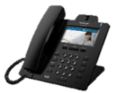
14. Main features
The voice terminal with camera will offer a variety usage !
Video and Audio communication !
Camera control !
- Pan
- Tilt
- Zoom
2
4 6
8
Control by DTMF
Video
Monitoring
7 9
Audio
5: Open the door
Event action !
Multiple
connection !
- Voice
- Video motion
email
Max.10
Video connection
outgoing
Video
Video
Audio
Notes:
7

Slide 8
Chapter 2 Basic Configuration

Slide 9
21. KX-NTV150 / 160
KX-NTV150 : Communication SIP Camera - PoE / AC adapter
- LAN / Wi-Fi - Built-in Speaker and Microphone - Call button
- Indoor use only KX-NTV160 : SIP based Video Doorphone - PoE only
- LAN only - Built-in Speaker and Microphone - Call button - IP-Grade : IP43
IP43：Ingress Protection dust-proof grade 4, waterproof grade 3
Notes:
9

Slide 10
22. KX-NTV150
KX-NTV150 : Communication SIP Camera
Camera Lens
Rear Side
・AC Adapter Power Jack
・Ethernet Port (RJ-45)
・External I/O Port
・WPS/Reset Button
Speaker
Call Button
Microphone
Status LED
Notes:
10

Slide 11
23. KX-NTV150 Specification
KX-NTV150 : Communication SIP Camera
Status LED | Indicate communication camera status
Hardware Key | Call button : Make a call, Cancel a call WPS/Reset Button - WPS : Push button more than 2 seconds and less than 10 seconds - System Reset : Push button more than 30 seconds.
Speaker / Microphone | Built-in Speaker / Built-in Microphone
Installation Method | Put on the desk, fixed by stand,
Ethernet Port | 10Base-T/100BaseTx, RJ-45 connector, PoE (IEEE802.3af) supported
Wireless | Wi-Fi (802.11b/g/n, 2.4GHz) Supported, internal Wi-Fi antenna (2x2)
Power Supply | 1.use AC adapter option KX-A239 2.use PoE
External I/O | Input: 1ch -> digital input: for example, detect that buzzer button was pushed Output: 1ch -> Main usage: drive relay parts for door openner
IP Protection | No (Indoor use only)
Notes:
11

Slide 12
24. KX-NTV160
KX-NTV160 : Video door phone
Camera Lens
Rear Side
・Ethernet Port (RJ-45)
・External I/O Port
Light Source LED
Speaker
Call Button
Microphone
Status LED
Reset Button
Notes:
12

Slide 13
25. KX-NTV160 Specification
KX-NTV160 : Video door phone
Status LED | Indicate video door phone status
Light Source LED | Emitting for visible in night, emitting color: ”Warm-white”
Hardware Key | ･Call button: Make a call ･Reset button: System reset Push button more than 30 seconds.
Speaker / Microphone | Built-in Speaker / Built-in Microphone
Installation Method | Wall mounted
Ethernet Port | 10Base-T/100BaseTx, RJ-45 connector, PoE (IEEE802.3af) supported
Power Supply | use PoE only
External I/O | Input: 1ch -> digital input: for example, detect that switch was pushed Output: 1ch -> Main usage: drive relay parts for door openner
IP Protection | Equivalent of IP43 at installed condition
Notes:
13

Slide 14
26. Main features
1. Video and Audio communication
NTV150/160 can make a video and audio call communication.
2. Camera Control
NTV150/160 have ePTZ and door opener which are controlled by DTMF from PBX terminals.
ePTZ : electronic pan-tilt-zoom
Notes:
14

Slide 15
26. Main features
Compatible Terminals
KX-NTV supports following Panasonic PT and IP phones.
Video Terminals
Model | Remarks
KX-HDV430 | Panasonic SIP Phone
SIP Softphone application | Bria SIP softphone (COUNTERPATH)
Audio Terminals
Model | Remarks
PBX Audio phone | NTseries, DPT, APT, SLT, SIP, etc.
Notes:
15

Slide 16
26. Main features
3. Event Action
Notification is available by event setting of NTV150/160.
SIP outgoing
Motion detection
Voice detection
Digital Input etc.
e-mail
e-mail
snapshot
Notes:
16

Slide 17
26. Main features
Event Setting
Schedule | Trigger | Action
- Sun, Mon, Tue, Wed, Thu, Fri, Sat - Time “Always” “From to [hh:mm]” | - Video motion detection - Voice detection - Periodically - Digital input - System boot - Recording notify - Camera tampering detection - Manual triggers | - SIP Outgoing - Server (Email or FTP or HTTP or Network storage )
Notes:
17
-Server Name-
default : blank
- Server Type-
Email or FTP or HTTP or Network storage selected by radio button
When Event is set on Motion detection
-Media Type-
Snapshot or Video clip or System log selected by radio button
default : no check

Slide 18
26. Main features
4. Multiple Connection
NTV150/160 can support Maximum 10 multiple video connection.
Video
SIP Call
1 Connection
Audio
Video
Total MAX
10 Connections
NTV150/160
Video
Web access or
Viewer APP
by RTSP Protocol
Video
:
:
9 Connections
(Max 10)
:
:
Video
Video
Notes:
18

Slide 19
Chapter 3 AK and Conditions

Slide 20
31. Activation Key
AK for KX-NTV is required for KX-NTV instead of User AK in NSX series. AK for IP extension is required for KX-NTV like a NT phone in NS series.
To connect | AK for IP-PT (KX-NSM) | AK for Peripheral Device (KX-NSXN )
KX-NS series | Required
KX-NSX series |  | Required
KX-NTV150
KX-NTV160

Slide 21
32. Conditions
NTV150/160
SIP Outgoing
When push the call button, it will start to make a call.
One telephone number can be assigned for destination. (up to 32 digits)
Output port control
It will be controlled during the talking.
Only NT55x,NT54x and SIP terminals can send DTMF control signal.
Viewer
Embedded WEB Server | OS: Windows 7 / 8 / 10 Browser: IE7 / IE8 / IE9 / IE10 / IE11 / Firefox
Embedded WEB Accounts | 20 accounts admin / operator / Viewer
Embedded WEB Access Restriction | Up to 10 users
Notes:
21

Slide 22
32. Conditions
NTV150 only
Wi-Fi
TYPE | IEEE802.11 b/g/n 2.4GHz
Antenna | 2x2
Channel | 1-13ch(for NE etc. except US) / 1-11ch(for US)
Security (Encryption) | WEP(64bit/128bit), WPA(TKIP/AES), WPA2(TKIP/AES)
WPS (Wi-Fi Protected Setup) | supported
NTV150/160
Ambient Temperature
NTV150 | 0 ~ 40 degrees Celsius (Operating range)
NTV160 | -10 ~ 50 degrees Celsius (Operating range)
Notes:
22
NTV160は積極的に屋外使用とは言わない。 社内の屋外製品規定に適合していないため。

Slide 23
Thank you !

Slide 24
Appendix

Slide 25
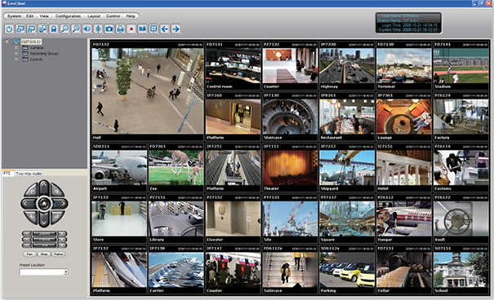
Appendix
Viewer Application
Vivotek ST7501 and iViewer
Vivotek ST7501(CMS) and iViewer(Viewer APP for Mobile) can connect to NTV150/160 and User can operate all function of them .
Vivotek ST7501(CMS)
Features
- 32-channel Live Video Monitoring
- PTZ/ePTZ Function Control
- Event Alarm Management
- Overall Device Management through Intuitive E-map Feature
- Two-way Audio, Multi-channel Audio Broadcast
- Instant Replay & Playback on Live Client
- Auto Stream Size for Reducing Display Loading
- Directly Set up Basic Parameters for Cameras
CMS(Central Management Software)

Slide 26
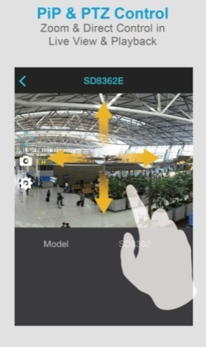
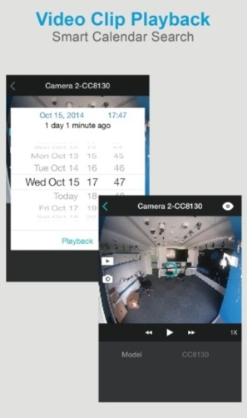
Appendix
Viewer Application
iViewer
Supported OS: iOS 6.0 or late, Android 2.3.3 or above
Features
- Multi-channel Live View & Single Channel Playback
- Variable-Speed Fast-Forward and Reverse for Playback
- Multi-Stream Selection
- Vertical (Portrait) or Horizontal (Landscape) Mode Rotation
- Snapshot Option
- PTZ Control
- PiP (Picture in Picture) Control
- One Way Audio

Slide 27
Appendix
Camera Block
Feature |  | KX-NTV150 / KX-NTV160
Image Sensor | Type | 1/3.2" Progressive CMOS
Lens | Type | Fixed-focal
 | Focus Range | ∞ ~ 0.4 (TBD) m
Field of View (Image aspect=4:3) | Horizontal | 92°
 | Vertical | 70°
 | Diagonal | 115°
Field of View (Image aspect=16:9) | Horizontal | 92°
 | Vertical | 52°
 | Diagonal | 106°

Slide 28
Appendix
Video (Live View Settings)
Feature |  | KX-NTV150,KX-NTV160
Number of Stream |  | 3 (Stream1, Stream2,Stream3) Stream1:for RTSP, Stream2:for SIP Stream3:for RTSP of mobile phone (Resolution is fixed QVGA(320x240))
Codec |  | Support H.264 and JPEG (only for RTSP)
Resolution |  | (Stream1 and 2) 1600x1200, 1280x960, 1280x720, 1024x768, 640x480, 640x360, 386x216, 352x288, 320x240,176x144
Frame rate | Maximum frame rate setting | (Stream1 and 2) 1,2,3,5,8,10,12,15,20,25,30fps, customized(1 - 30fps)
 | Maximum performance | (Stream1 and 2) H.264: 30fps@1600x1200 30fps@1280x720 | (Stream1 and 2) MJPEG: 30fps@1600x1200 30fps@1280x720

Slide 29
Appendix
Audio
Feature |  | KX-NTV150,KX-NTV160
Echo Canceller |  | Include function of echo canceller Half Duplex
Mute for Microphone | Activate | ON/OFF
Volume control for Speaker | Microphone input gain | Level tuning (1~100%)
Mute for Speaker | Activate | ON/OFF
Volume control for Speaker | Speaker output gain | Level tuning (1~100%)
Codec |  | Support G.711, G.722(Only for SIP), G.729a(Only for SIP) select u-law or a-law

Slide 30
Appendix
SIP Terminal Features
Feature | KX-NTV150,KX-NTV160
Network Interface | 1 x RJ45, 10Base-T/100BaseTx
DTMF | Out band (RFC2833) / SIP INFO
TONE | Busy Tone / Ring Back Tone / Reorder Tone / Key Tone / Confirmation Tone
Embedded WEB GUI Language | English, Spanish, French, Italian, German, Portuguese, Russian
RTP / RTCP | Yes
RTCP-XR (RFC3611) & SIP PUBLISH | No
DNS-SRV (RFC3263) | No
LLDP / LLDP-MED | No
LDAPv3 | No
SNTP | Yes
NAT traversal | No

Slide 31
Appendix
SIP Terminal Features
Feature (Security) | KX-NTV150,KX-NTV160
Attack IP Packet Protection | Yes
SIP INVITE Attack Protection | No
IEEE802.1x | Yes
QoS | Yes
Digest Authentication using MD5 | Yes
AES Key Sizes | 128 / 192 / 256 bits
RSA Key Sizes | 2048 / 4096 bits
Admin/User Configuration Mode | No
WIFI WEP | 64bit/128bit(*onlyNTV150)
WIFI WPA(TKIP/AES) | Yes(*onlyNTV150)
WIFI WPA2(TKIP/AES) | Yes(*onlyNTV150)

Slide 32
Revision
Date | No. | Change
October 26, 2015 | All | First draft
Notes:
32

