Slide 1
2N® Access Commander
Product presentation

Slide 2
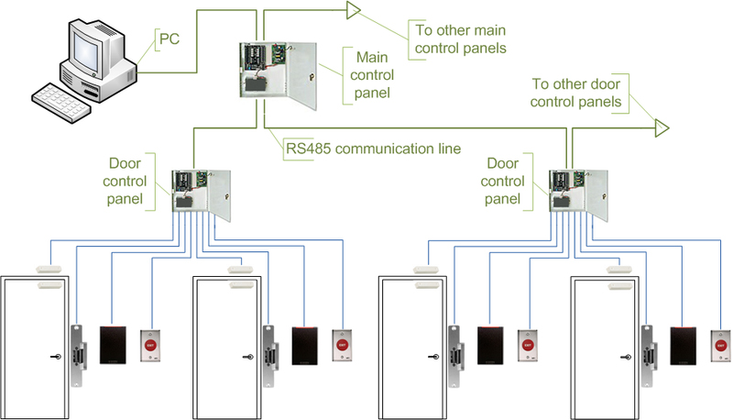
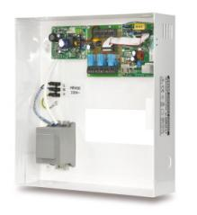
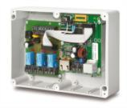
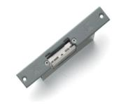
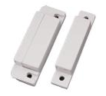
Traditional access control systems Components & topology
Readers
Door / Central controller
Wiring + Power
Peripherals

Slide 3
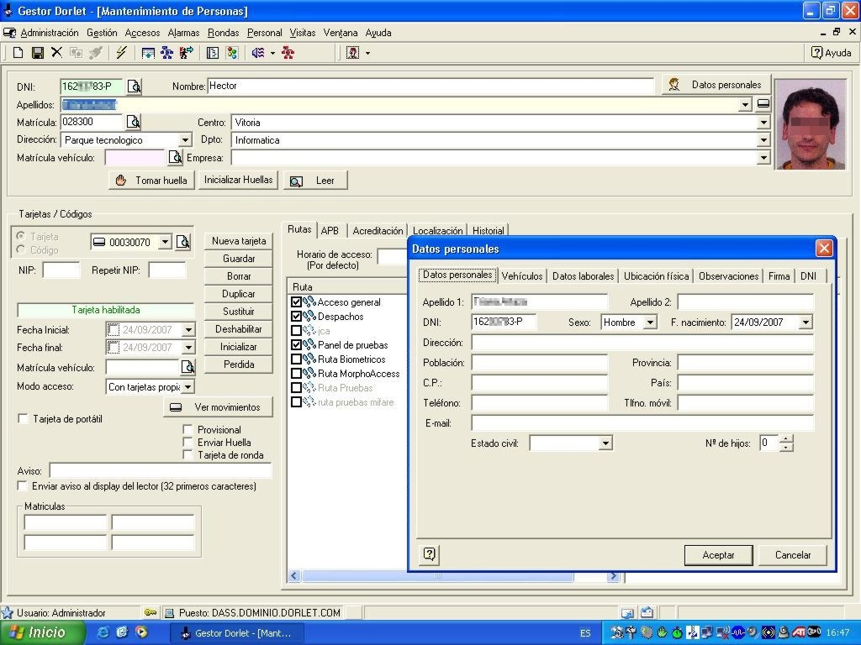
Traditional access control systems Configuration tool
Configured via thick client
Need to install special program to PC
Designed mainly for trained people
Non-intuitive system

Slide 4
Traditional access control systems Overview & disadvantages
Installation
Lots of devices, controllers, splitters and proprietary wiring
Users
User database stored in controllers or in master units
Security
Central point of failure
Difficult remote moniroting

Slide 5
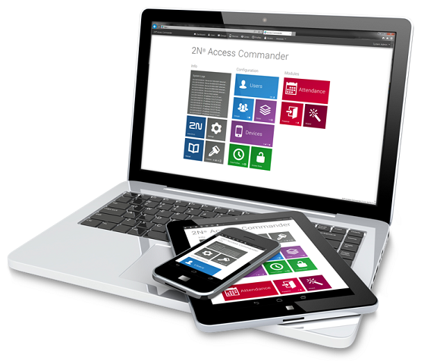
2N® Access Commander

Slide 6
Basic description
New software tool for Access Control management from 2N
Pure IP system
Simple and intuitive web interface with wizard
Easy to operate by non professionals

Slide 7
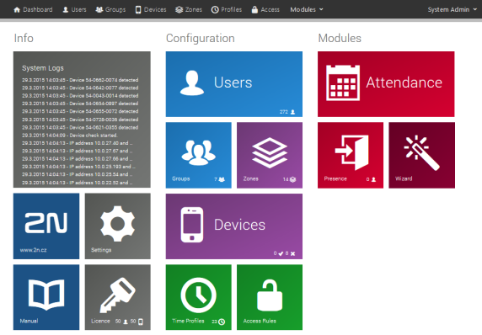
Typical usage
Setup & monitoring of access control system
Bulk setup of Helios IP intercoms and 2N® Access Units
Integrated attendance system

Slide 8
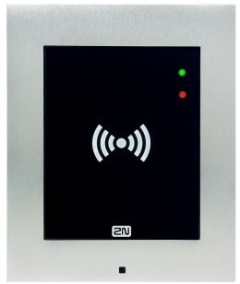
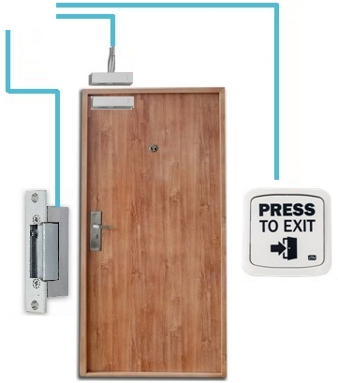
2N access control systems Network connection & peripherals

Slide 9
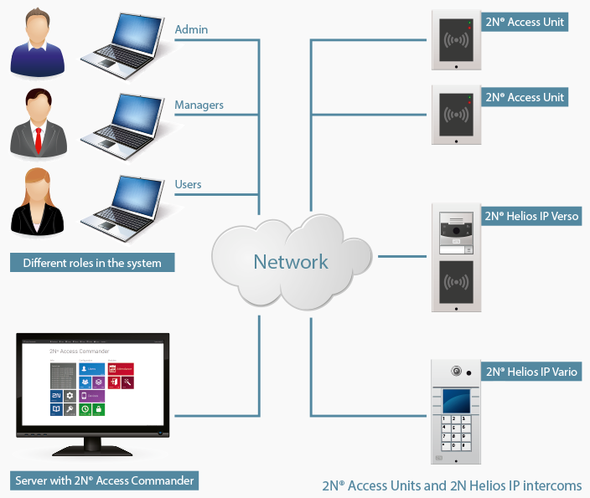
2N access control systems Topology & roles

Slide 10
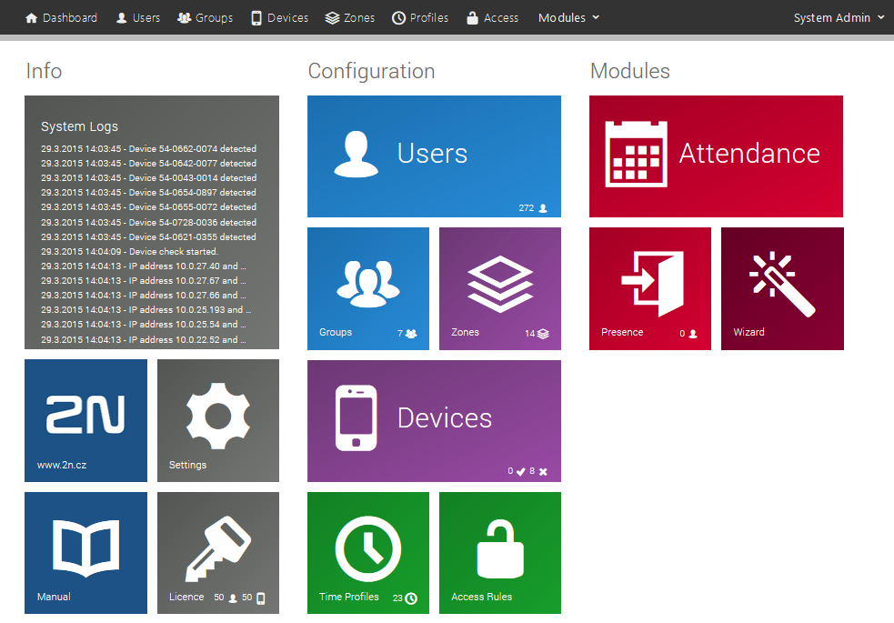
Admin dashboard

Slide 11
Integrated network scanner
List of all devices with basic status
Direct access for device setup

Slide 12
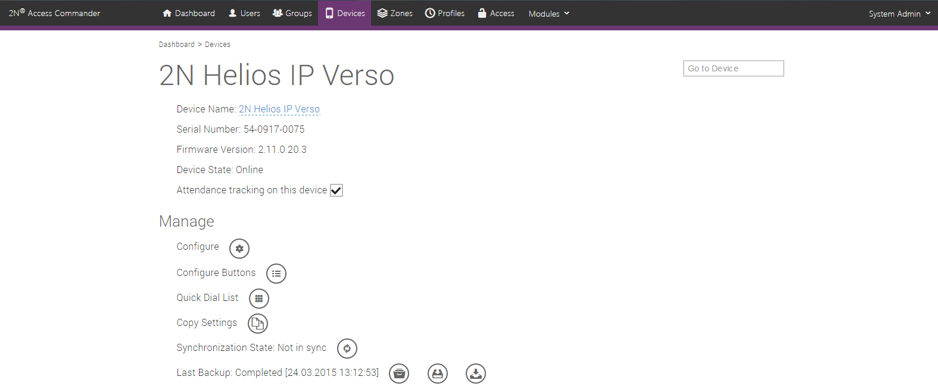
Device setup screen
Access to web
interface of
selected device
Access to direct
call buttons
configuration
Management of quick
dial numbers for
keypad equipped units
Setup copying
to other units
(bulk edit)

Slide 13
Benefits for ICT
Unlike classical access control systems ours is using IT friendly language so it will not take more time than drink morning coffee to master it for average IT guy
We are using the same hardware like IT are used to - switches, routers, servers, UTP cables……

Slide 14
Benefits for Installers
Short time of installation with no special & expensive tools needed
No need to carry many pieces of hardware like cabling, door controllers, batteries or tools to installation site

Slide 15
Benefits for End Users
Low TCO due to simplicity of the whole system
No need to train any personal to be able to master the system
Simple to expand in future thanks to IP technology

Slide 16
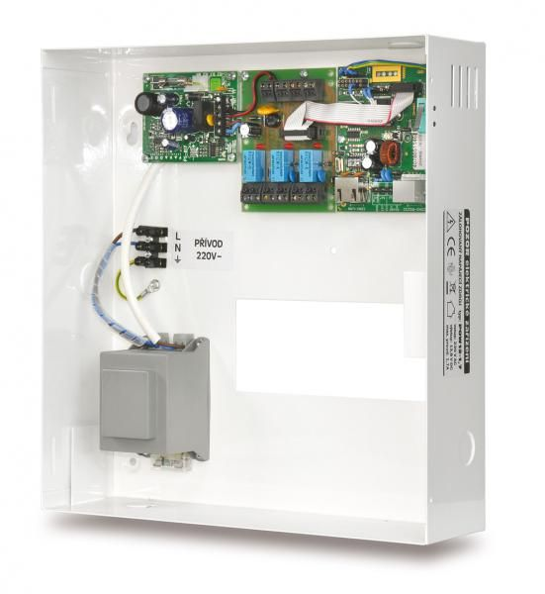
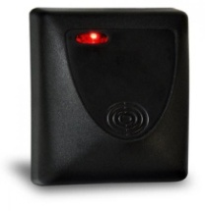
Price Comparison - Estelar
2N Solution
Estelar solution
Reader
2NAccess Unit ~350 EUR
Lock connection
2N Security Relay 76EUR
Total
426EUR
Reader
EDK4B ~221 EUR
Door controller
AS3003 ~285 EUR
Total
506 EUR

Slide 17
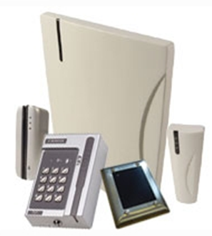
Price Comparison - Siemens
Installed readers

Slide 18
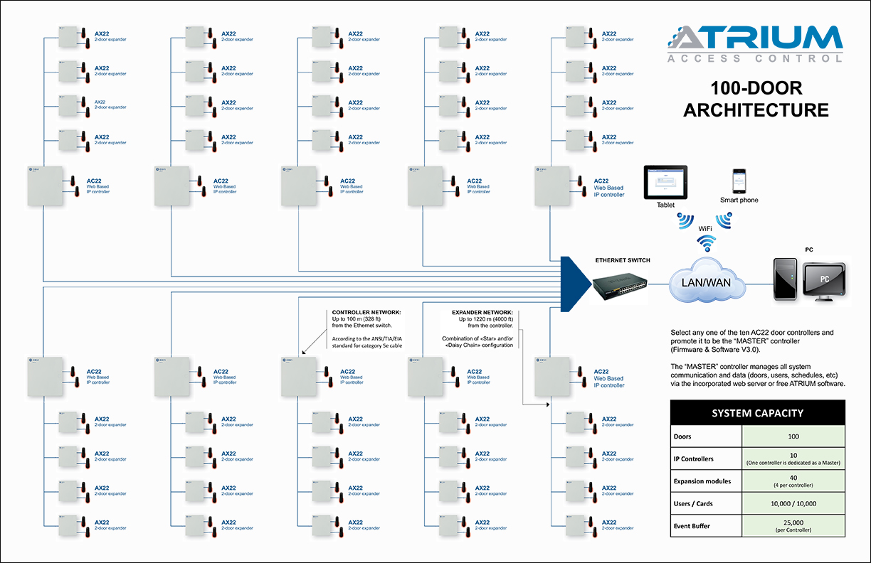
Price Comparison – CDVI Atrium
2N Solution
CDVI solution
Reader
80x 2N Access Unit ~320 EUR
Lock connection
2N Security Relay 76EUR
Total
31680EUR
Reader
80x iClass R10 ~100 EUR each
Door controller
40x AX22 ~732 EUR each
Central controller
10x AC22 ~689 EUR each
Total
44170 EUR

Slide 19
Licensing policy
1 device and 1 user can be configured for FREE!
Packages for additional devices and users:
91379040 – license to add 5 devices
91379041 – license to add 25 users for Attendance and Presence

Slide 20
Thank you for your attention
Contact us at:
sales@2n.cz

