Slide 1
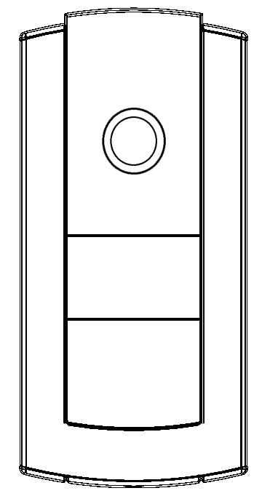
2N® Helios IP Base
Sales Presentation

Slide 2
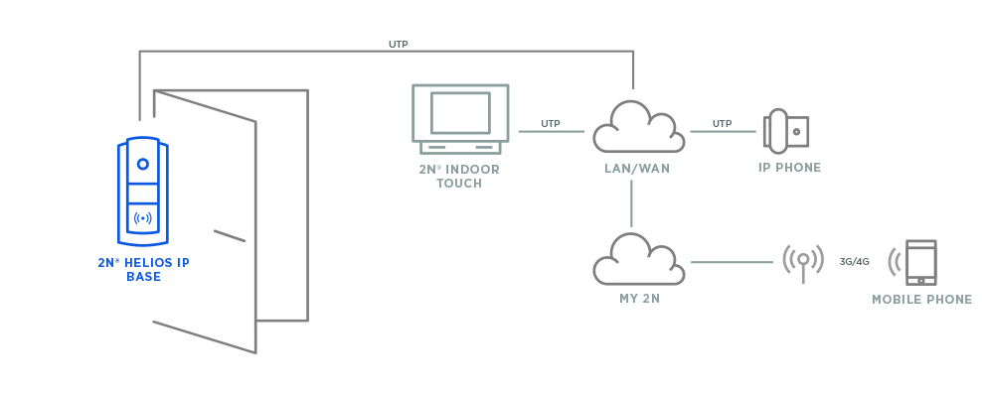
Connection Topology

Slide 3
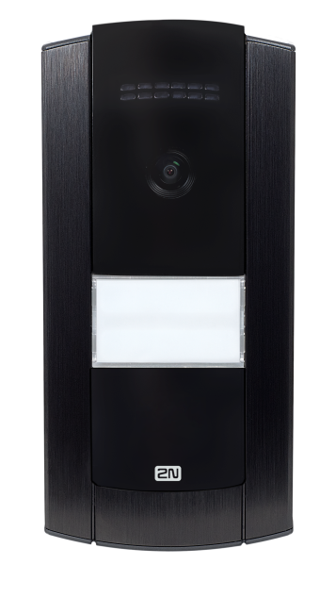
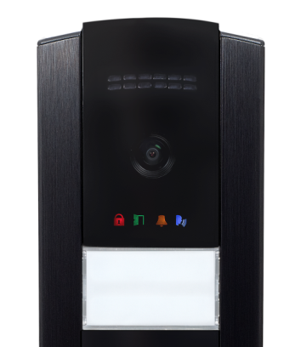
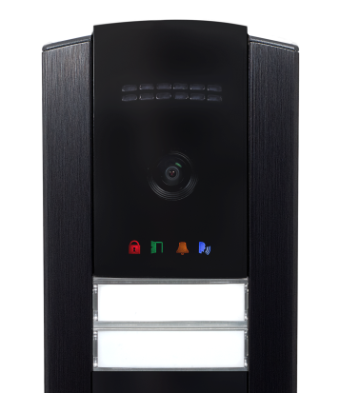
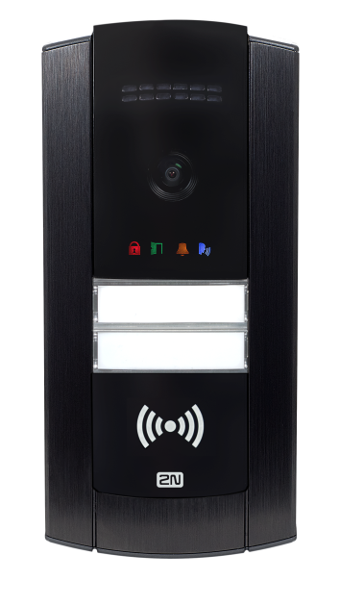
Possible Configurations & Features
One button & Camera
Pictograms
Two buttons & Camera
RFID reader as accessory
One large button is part of the package

Slide 4
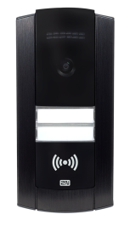
Positioning in 2N Portfolio
BASIC FEATURE SET PROFESSIONAL
 | NO CAMERA YES
Installation size

Slide 5
Target Verticals
Residential
Single villa installations
One or two buttons
Combination with 2N® Indoor Touch
2N® Mobile Video service compatible
Office
Small Office installations (SOHO)
RFID reader as accessory for access control

Slide 6
Unique Selling Points
Straight forward solution – 2N® Helios IP base together with 2N® Indoor Touch brings full solution for home video door phone with
All in one box – no need to order mounting accessories everything needed for installation is inside the box
3-Step installation – spend time by doing business not by installation
Notes:
Straight forward solution – distributor doesn’t need to think about accessories, different combinations or finishes – solution is really one stop – take it or not.
All in one box – all you need for installtion is inside one box making distribution easy and time effective
3-Step installation - – 1.fix it to the wall 2.connect UTP cable 3.close the frame

Slide 7
Accessories
Metal Mounting Back Plate
For uneven surfaces
no need for normal installation
Ready to be mount on…
One gang BOX
Two gang box
68mm installation box

Slide 8
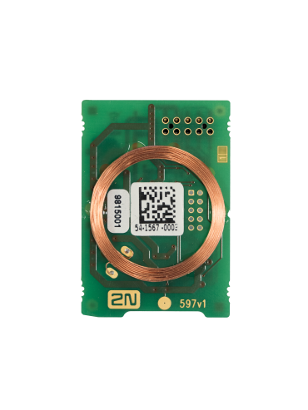
Accessories
RFID card reader
125kHz (prox card)
13,56MHz (smart card)

Slide 9
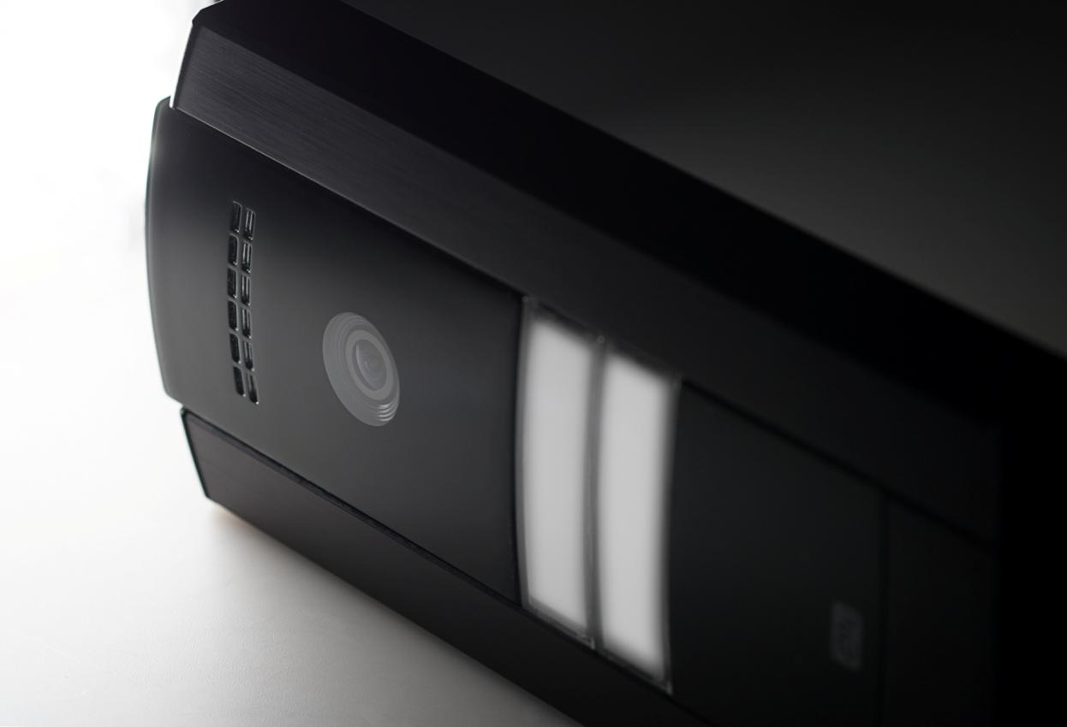
Technical Specifications
Camera 1280x960, 135° x 109°
IP65, IK07
PoE or 12VDC power input
Active 12VDC or relay OUT

