Slide 1
2N® Access Unit
Product presentation

Slide 2
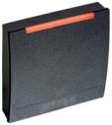
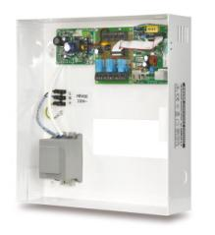
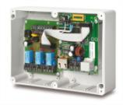
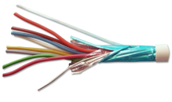
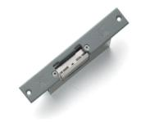
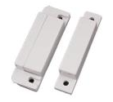
Components of Traditional Access Control System
Readers
Door / Central controller
Wiring + Power
Peripherals

Slide 3
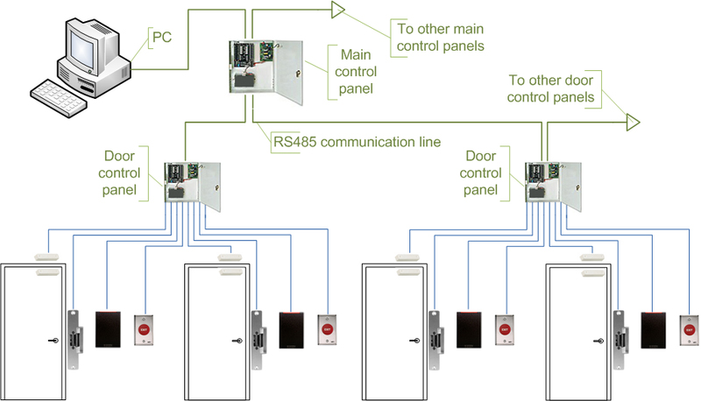
Topology of traditional ACS

Slide 4
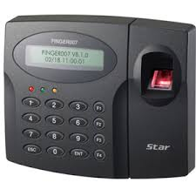
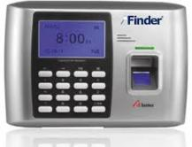
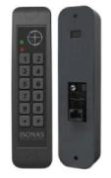
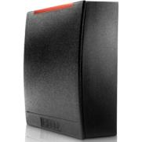
Direct Competitors
IP Enabled controller
ASP 465 EUR
Edge device
ASP 425 EUR
Kintronics ISONAS
EUP 700 EUR
HID Solo ESR40
EUP 765 EUR

Slide 5
Traditional access control systems Overview
Installation | Users | Security
Lots of propietary wiring Lots of devices, controllers, splitters | +- User database in controllers or master stations | Central point of failure Difficult remote monitoring

Slide 6
IP based access control systems Overview
Devices | Users | Security
+ Group configuration + Time effective use + System monitoring + User rights for system access + IT-friendly | + All users stored in endpoints + Backup of access control rules + Homogenous databases | + No central point of failure + Event logging + System monitoring

Slide 7
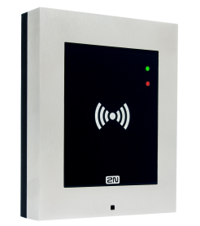
2N® Access Unit

Slide 8
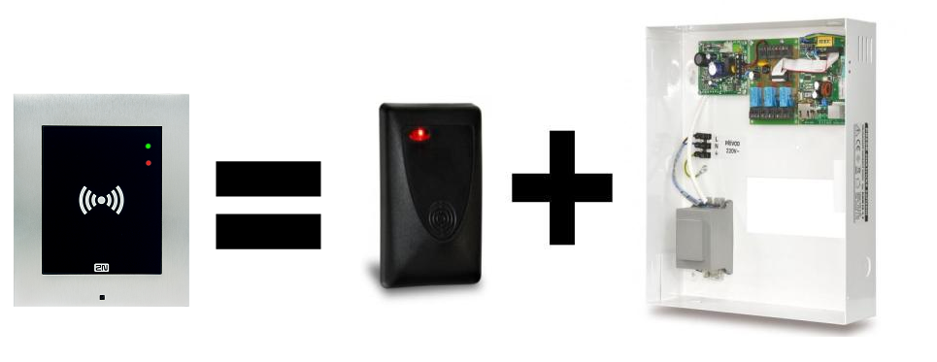
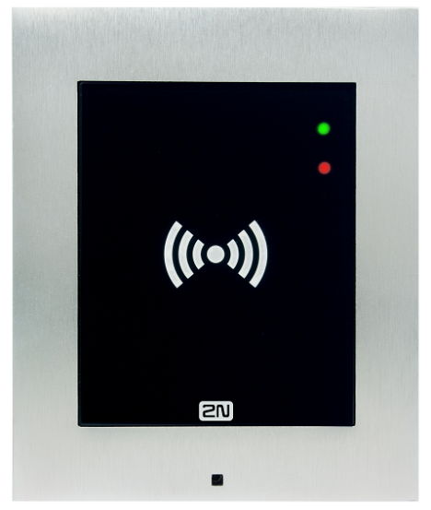
Basic description – I.
Pure IP standalone unit
Card reader, door controller and IP converters in a single device
Luxury Verso design
Compatible with Helios IP Family

Slide 9
Basic description – II.
Simple installation without the need for expert knowledge
only Ethernet at door is needed
NFC ready – use your smartphone with NFC and HCE to open door
Compatible with 2N® Helios IP Verso accessories

Slide 10
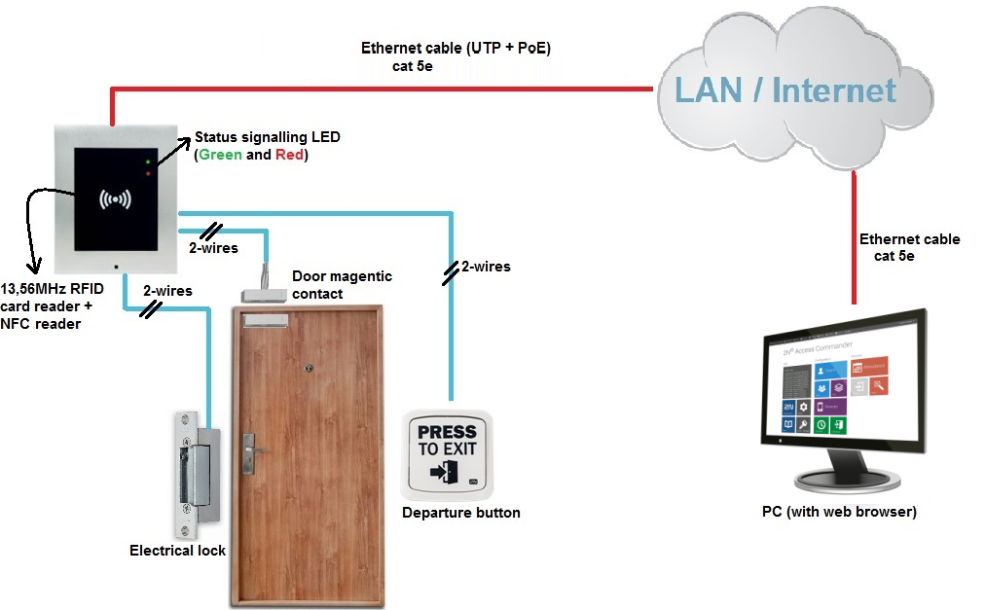
Basic interconnection Door

Slide 11
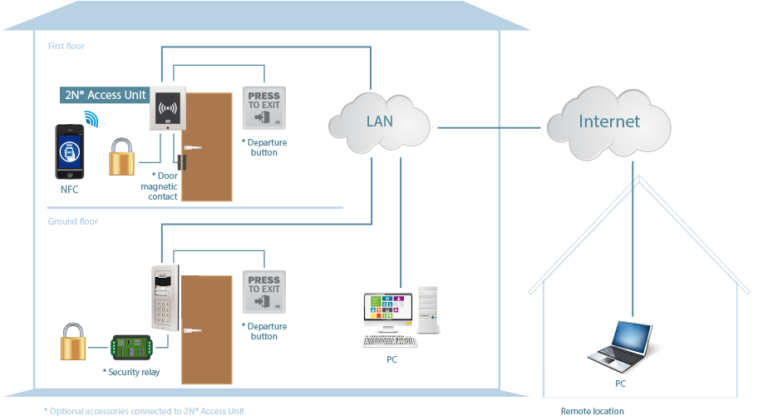
Basic interconnection Network

Slide 12
Features description
Web based configuration
Compatible with 2N® Access Commander
Event logging, attendance tracking
Antivandal & still elegant

Slide 13
Technical parameters – I.
Connection: UTP cable
Power supply: PoE / 12VDC
Inputs: 3
Outputs:
1 active (12V / 400mA) – feeds the door strike even from PoE
1 passive Relay (NO/NC)

Slide 14
Technical parameters – II.
13,56 MHz reader NFC Ready
NFC is licensed
Onwall / Flush mount installation
Outdoor / Indoor use
IP coverage: IP54 (IK08)

Slide 15
Thank you for your attention
Contact us at:
sales@2n.cz

