Slide 1
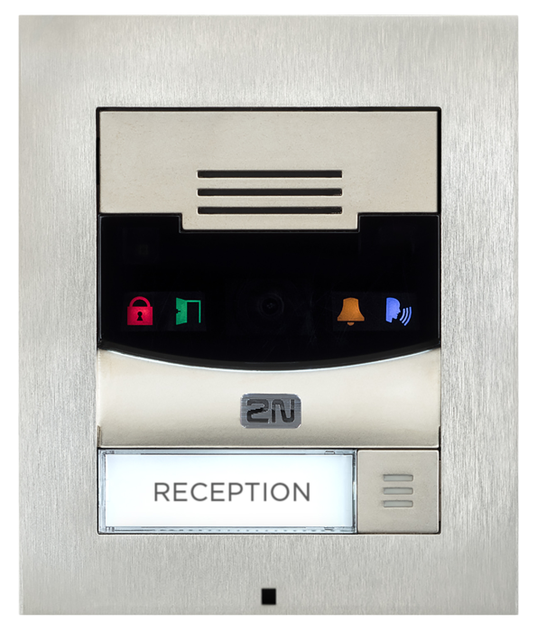
2N® Helios IP Solo
The Compact IP Intercom

Slide 2
2N® Helios IP Solo
VERTICALS
Office
Residential
OEM

Slide 3
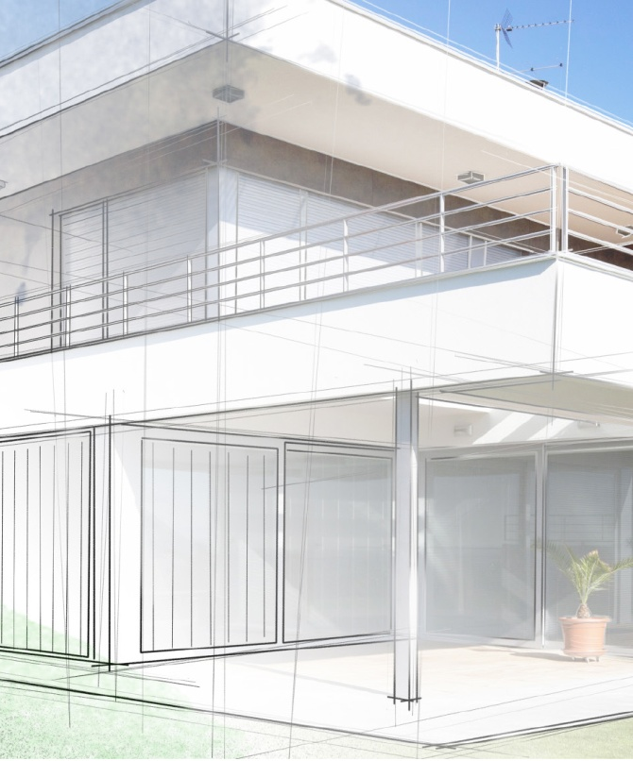
2N® Helios IP Solo
Makes the entrance part of any Smart Home
Video calls and door control integrated into your smart home system.

Slide 4
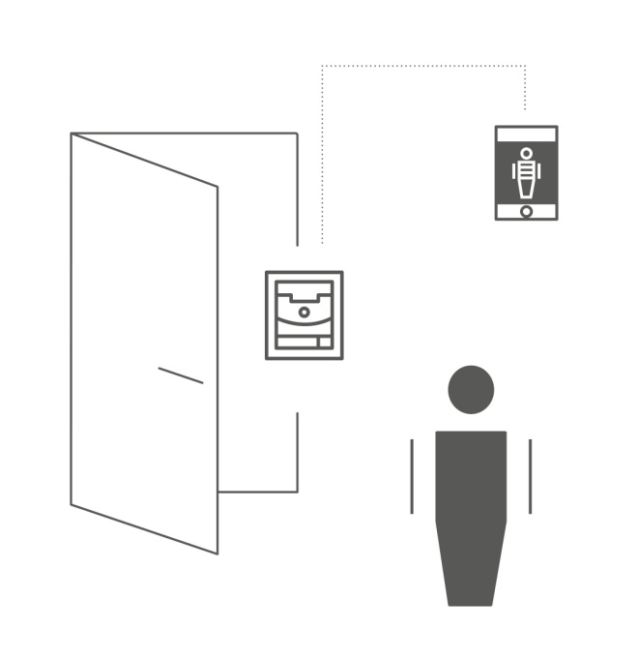
2N® Helios IP Solo
Sharp video day and night
A hidden camera produces sharp images with HD resolution and night-vision so you can see visitors clearly, even in the dark.

Slide 5
2N® Helios IP Solo
Stylish and durable
A luxurious surface of brushed zinc represents any entrance in style.
All components and materials are industrial high-grade so as to ensure excellent performance under any conditions.

Slide 6
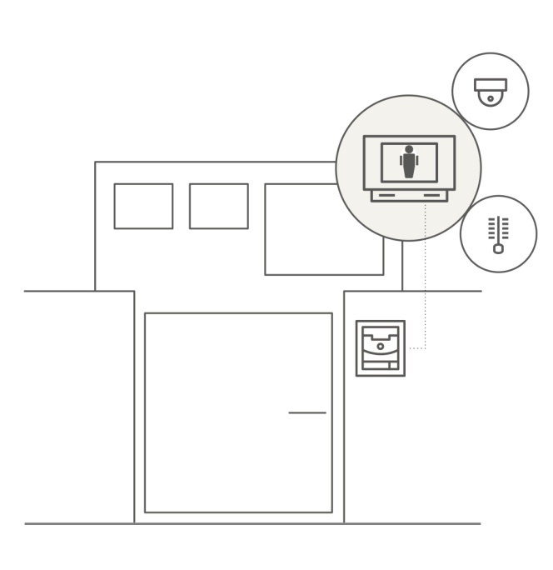
2N® Helios IP Solo
Integration
Various integration scenarios with a lot of Home Automation systems thanks to open HTTP API, Automation functionality in Helios IP and ONVIF support.

Slide 7
2N® Helios IP Solo
CONNECTION TOPOLOGY

Slide 8
2N® Helios IP Solo
INTEGRATION WITH 3RD PARTY PRODUCTS
Cisco
Avaya
Alcatel-Lucent
Fritz
Skype
Gigaset
Asterisk
Yealink
Wildix
Milestone
Axis Communications
Genetec
DigiFort
Axxon
Onvif
See Tec
Aimetis
Digivod
Netavis
Control4
Savant
Fibaro
TELEPHONY
VIDEO MANAGEMENT SYSTEMS
HOME AUTOMATION

Slide 9
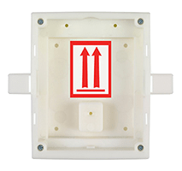
2N® Helios IP Solo
Accessories
Backplate
9155068
Box for Installation in the Wall
9155017
Notes:
Maximálne koľko je možných konfigurácií?

Slide 10
2N® Helios IP Solo
Technical Specification
Signalling protocol: SIP 2.0 (RFC - 3261)
Microphone: 1 built-in microphone, Speaker 2W
Camera (optional) Resolution: JPEG 1280 x 960px – video call 640 x 480px
Viewing angle 120° (H), 90° (V), 145° (D)
Night vision: Yes Automatic IR cut filter and IR light
Video stream: Codecs H.263+, H.263, H.264, MJPEG, MPEG-4
Power supply: 12V ± 15%/ 2A DC, or PoE 802.3af (Class 0 - 12.95W)
Notes:
Maximálne koľko je možných konfigurácií?

